Slide 1
Personal Money Budget App
SELECT
Mytreyi Reddy,
Sourabh wadhwa,
Ananya Kondiparthy
FROM uncountables
WHERE PROJECT = ‘DBMS’;

Slide 2
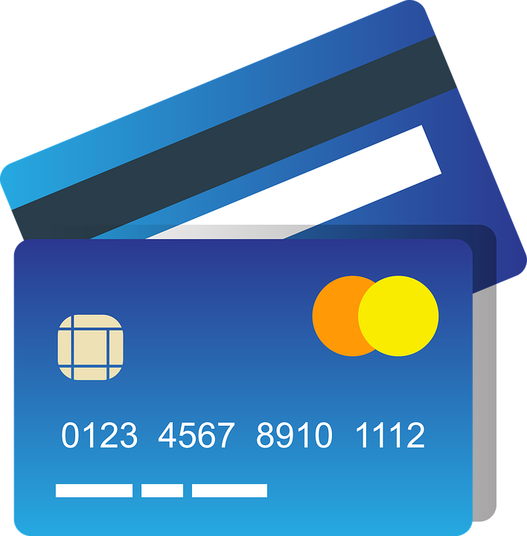
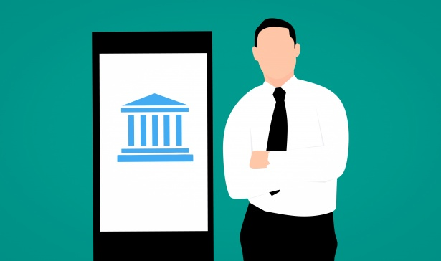
Project Overview
The project is about the database for a mobile app that will help its users in personal financial budget management.
The expenses that are made using the bank accounts and cards of the user that are linked with this app will automatically be updated as "Transactions".
These transactions are classified in "categories of purchases"
The user can save the recurring expenses like example monthly mobile bill payments, credit card dues, and loan installments. Using this data app will give a reminder to users to pay before the due date which we term as "Future Payments".
Overall, this business application will give a clear view of the user’s budget and expenses.
Notes:
The project is about an app related to personal budget Management system. A user can add the expenses. The app can track all the expenses and and the user can set a certain monthly budget limit. Using all this information, the app gives a notification or reminder to the User, if the transactions exceeded the monthly budget limit or if it is within the limit. The transactions between the users and banking process is what we have listed as entities. Overall, this business application will give a clear view of the user’s budget and expenses.

Slide 3

Use Case- new categorization process
New Categorization Process:
The User can create his own category of spending area when new transactions are made.
Notes:
While coming to the usecases in this application. The first case is about the new categorization Process. Whenever a user spends, the expense is tagged or labelled to a category. So we created a few predefined categories in the system such as grocery expense, Entertainment, Utility bills. When there is a new spending category, the user has to manually create it. Lets see the swim lane for this categorization.

Slide 4
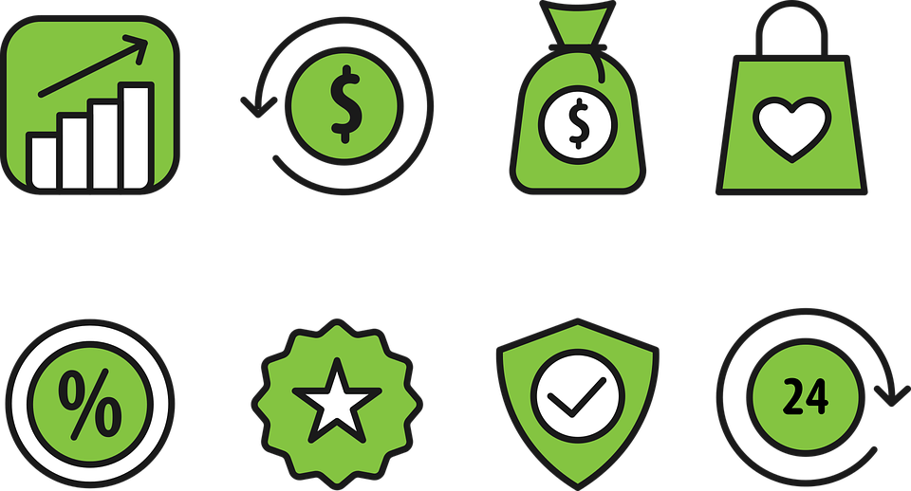
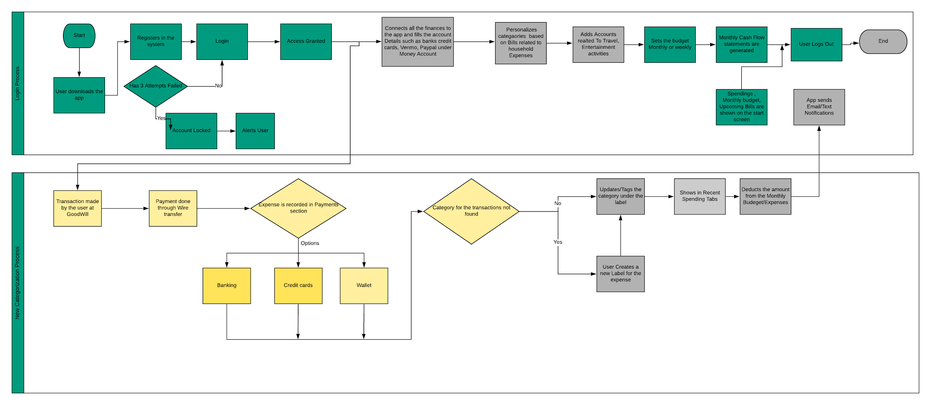
User Categories process
Notes:
the first is the login process . When the user registers in the application, he/ she adds all the financial information, personal details and sets a budget limit. This is the first process. So when the user makes a transaction at Goodwill store like a donation. The transaction details related to the payment is not specifically categorized in the system. In such a scenario, user can create his own category of spending area, so that transactions related to donations or any service related payments will fall into the specific section. This is the flow for a categorization process .

Slide 5

Use Case - user Split process
The Money paid by user on behalf of his friends can be splitted among his friends and only user’s share is updated/ tracked in his monthly expenses and Budget Management.
Notes:
The second use case, is about split process. When we go out with our friends and when only one person pays, we split the expenses.

Slide 6
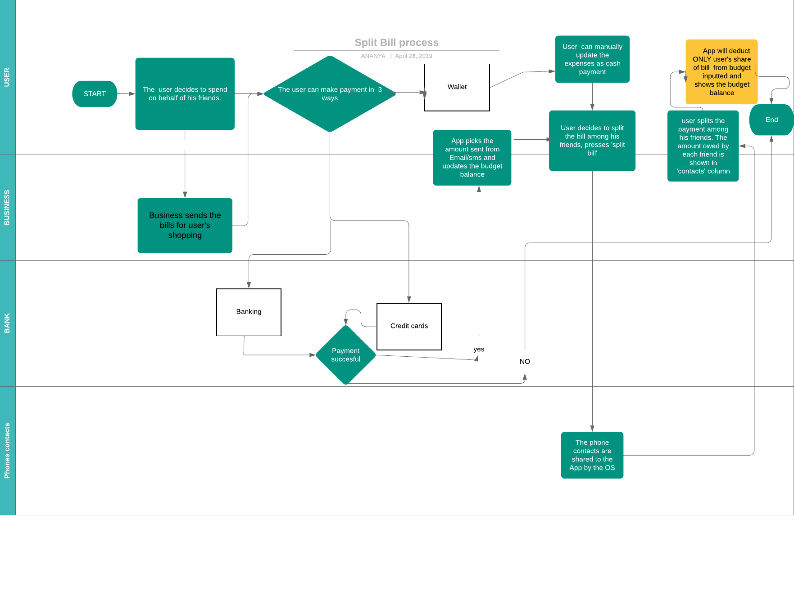
User Split Bill Process
Notes:
When one person makes a transaction through one of the payment type such as debit or credit cards . As these cards are linked to the app account, the transaction details gets updated in the system. When the user decides to split among his friends, then these contact details are retrieved from the phone and the bills are equally divided among the number of contacts. The total budget balance is updated by deducting only the user’s share and the process terminates .

Slide 7
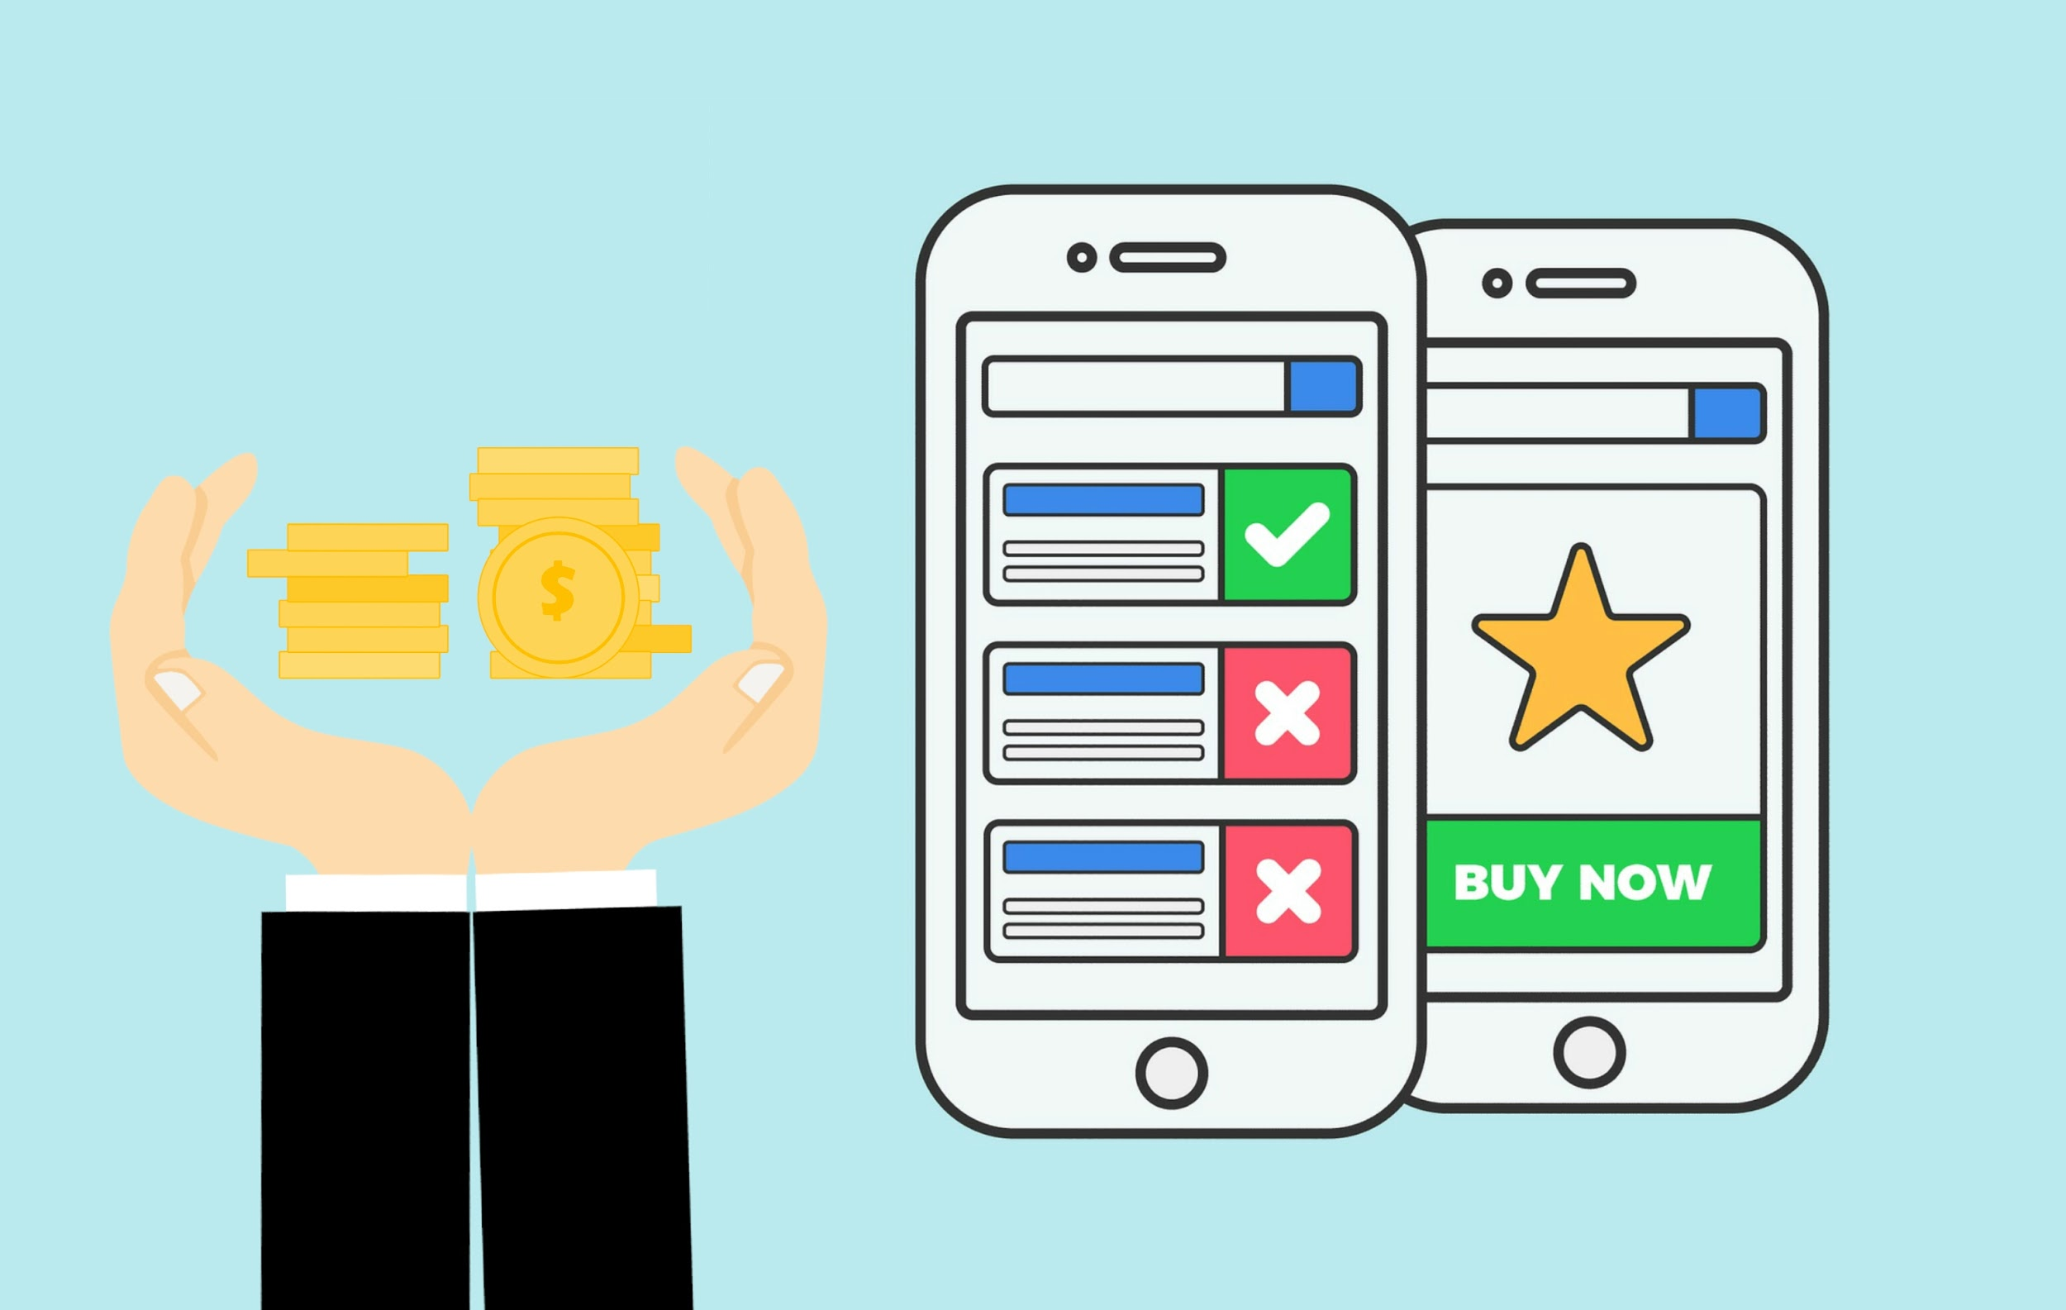
User Transactions
The user Transactions
Are Tracked by the App when
Ever the transactions are
Received by Mobile.
Notes:
The third use case is the detailed transaction process about the payment options and the updates in the app.

Slide 8
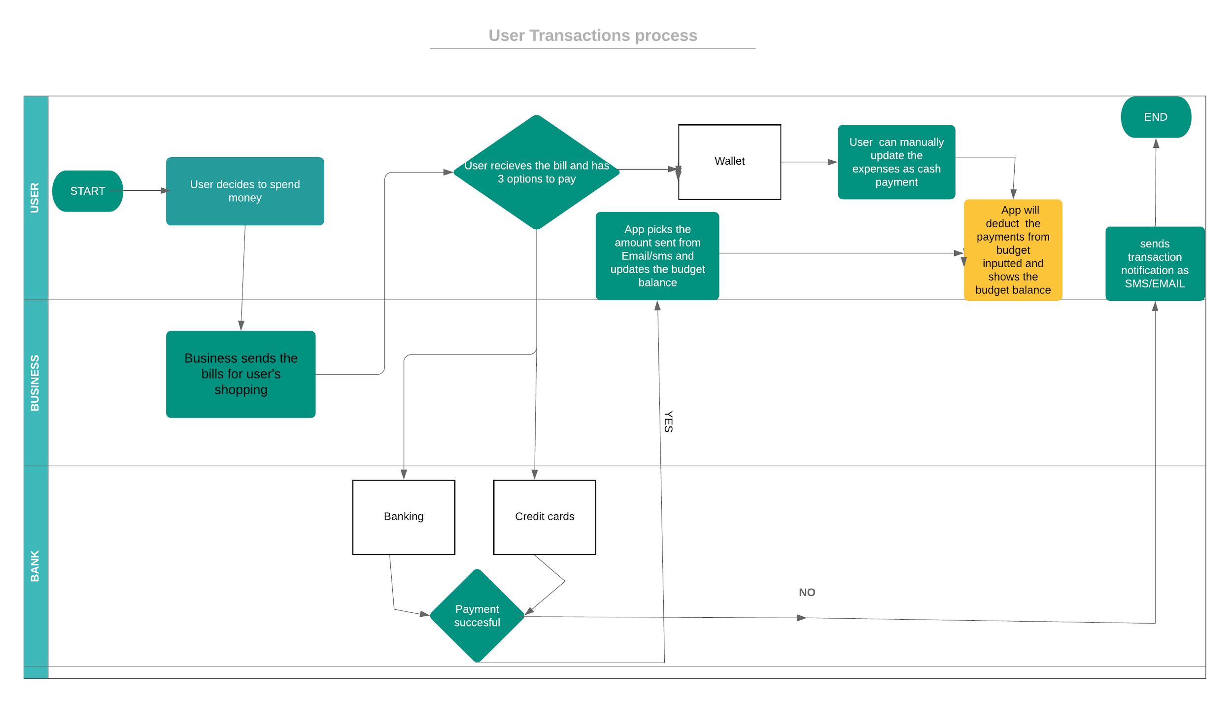
User Transaction Process swim lane diagram
Notes:
For example when user decides to spend in a store like Target . At the billing counter, the user can pay with either debit or credit cards. When the payment is successful, the app picks the details and deducts the amount from he budget limit. The user also has the option of paying through wallet, then the user has to manually update the payment as cash expense. If the payment is not successful, then the budget is not deducted and there will be a notification to the user that the transaction is failed. This is the in-depth flow of transaction process.

Slide 9
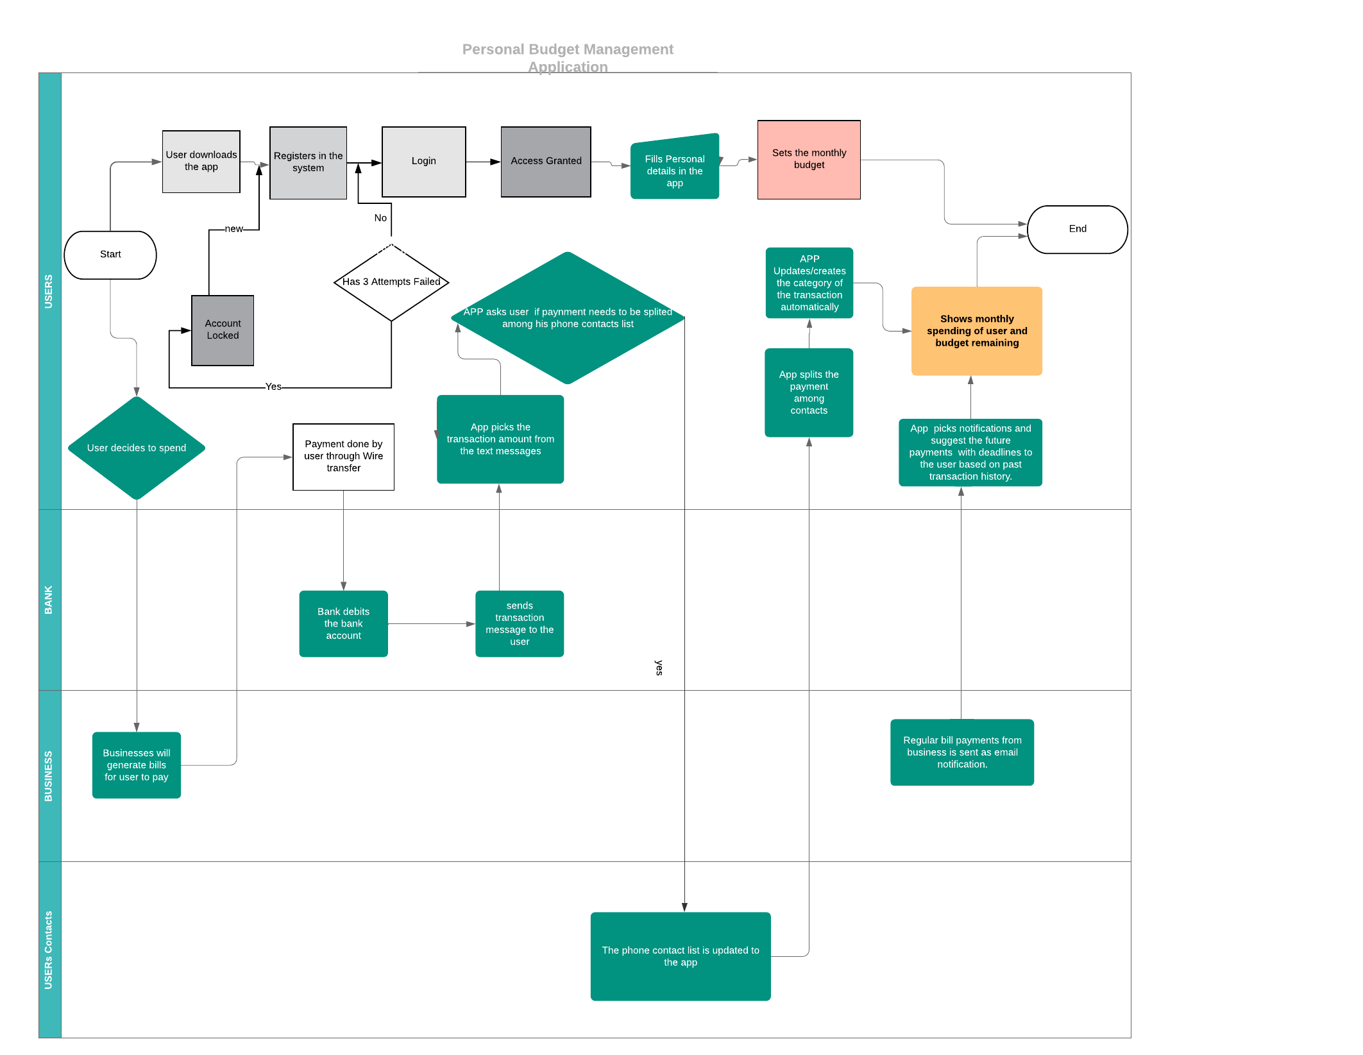
Overall swim lane Diagram
Notes:
We have merged all the sub process into a one swim lane diagram which depicts the major functionality of all categorization, transaction, split bills and recurring payments.

Slide 10
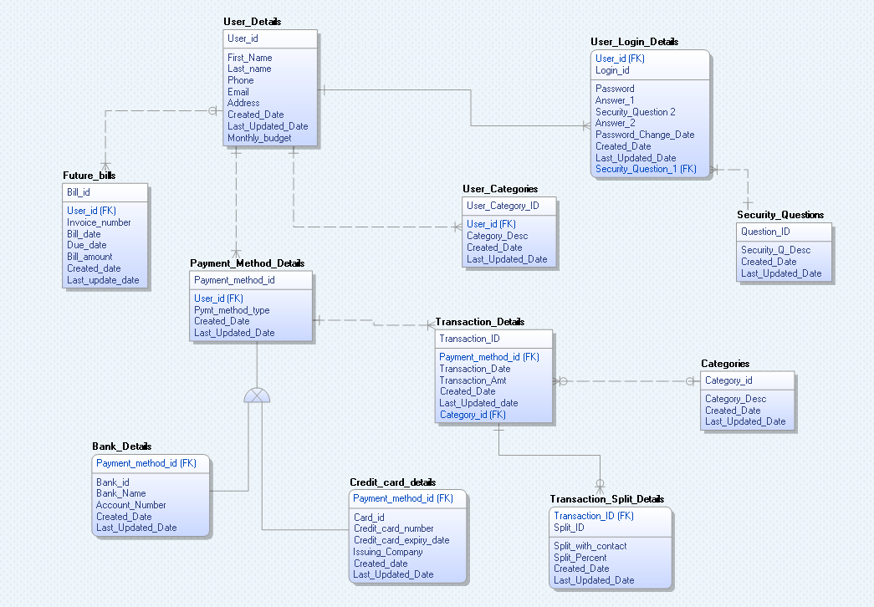
Data Model

Slide 11
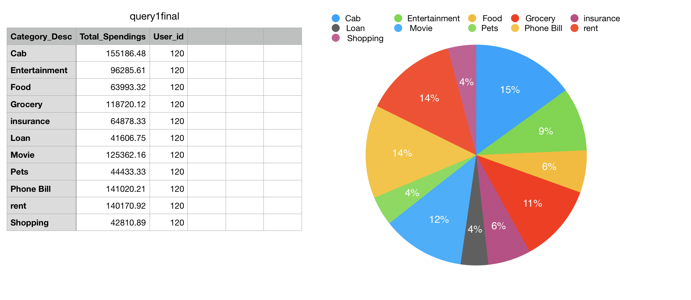
User budget visualisation

Slide 12
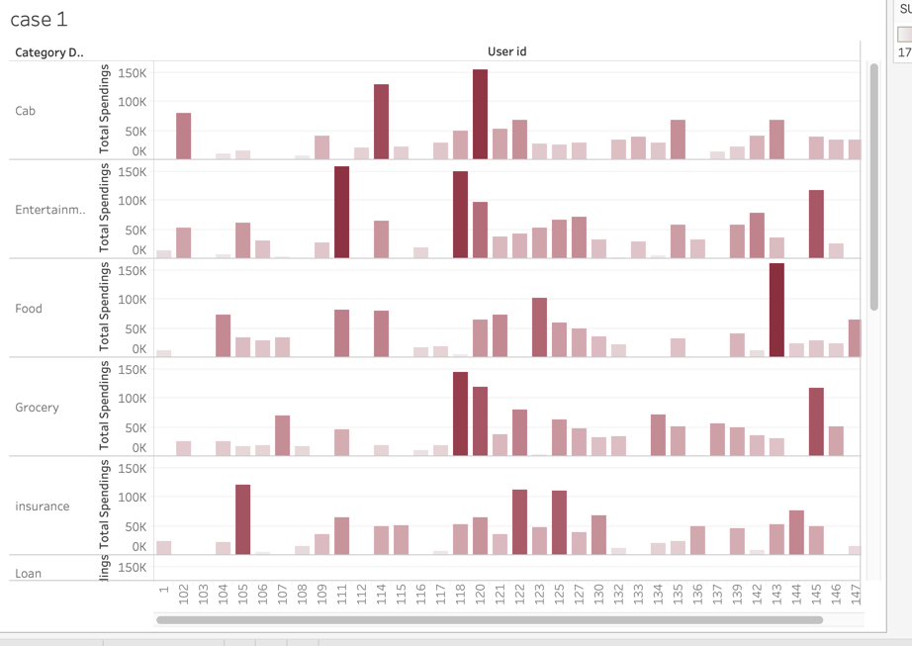
Category wise spending of the user

Slide 13
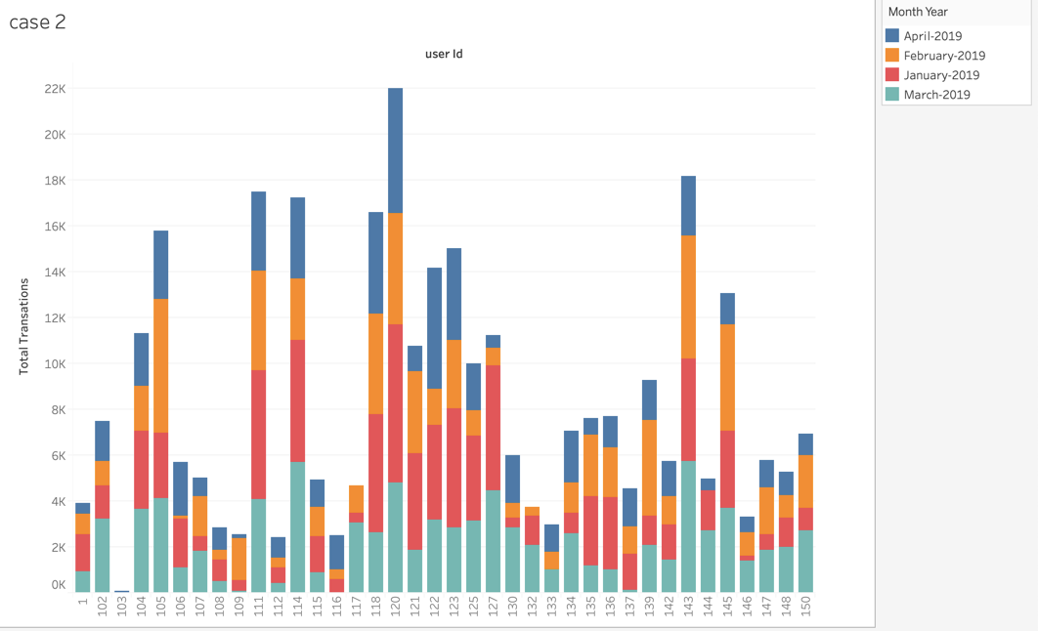
summary of previous month spending

Slide 14
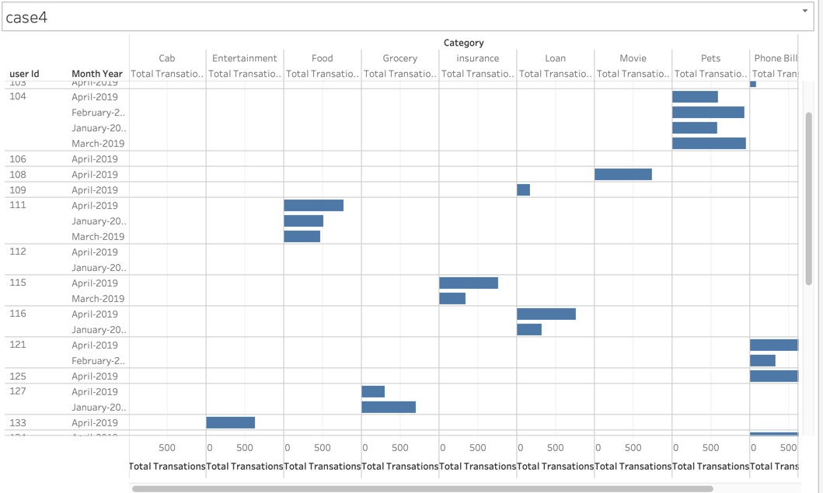
Most spent categories -Month wise

Slide 15
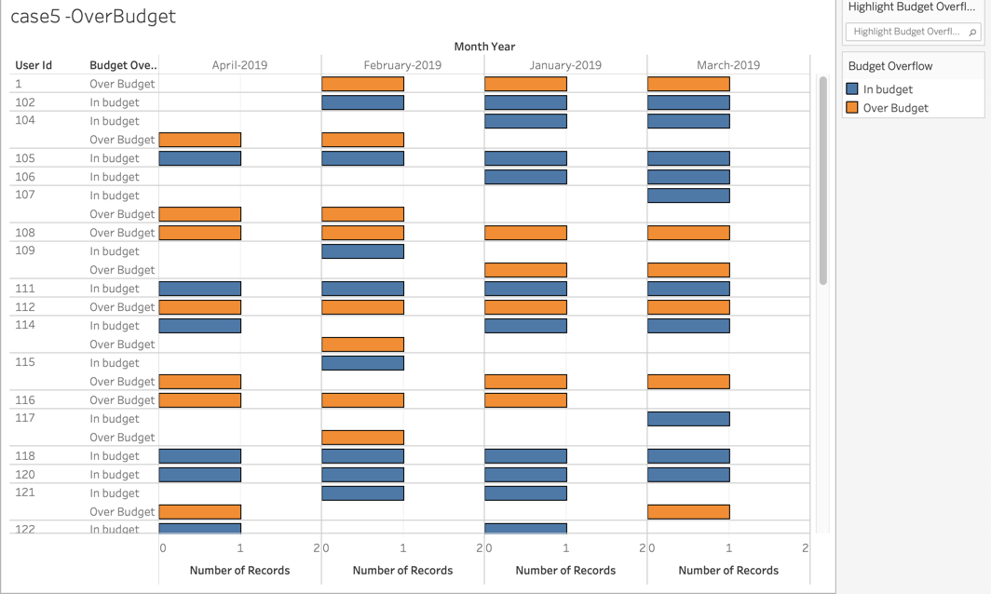
In -Budget or Over Budget?

Slide 16
Project Summary
Understanding the business is equally important to implementing the technical model.
Problems : 1. Had to change the data model as we have missed few of the attributes while creating the entities.
2. Inconsistency data problems while uploading the data. Example Split amount was more the original transaction amount.
To solve the first problem, we sat together and re-iterated to the functionality and changed the model according to the discussion and moved forward.
To solve the second problem, we wrote a query to find out all those records and updated them in a way that they will have a portion of transaction amount.
If we were to do the project again the we will spend more time in the initial phase of the project and make sure to double check the output of each phase.
Notes:
we learned that when designing a database, one should have a clear idea of the data model and the functionality that a process undergoes. Then we can easily dig down to create tables, and write queries on that application.
Forgot some of the attributes in the tables . Had to change the design and implement it again.

Slide 17

Questions>>>

Slide 18


